Slide 1
Reviews Spam detection filter
Robert Wolf
Introduction to machine learning
University of Washington Tacoma – winter 2020

Slide 2
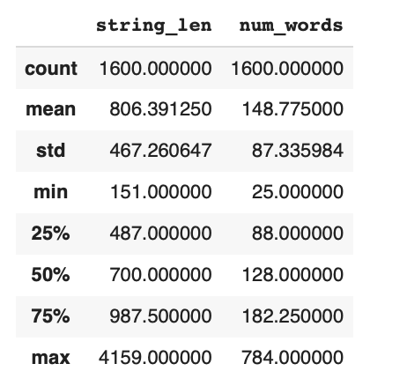
Input data
Truthful and Deceptive (spam) reviews for hotels
1,600 of each type
Range from 25 to 748 words long

Slide 3
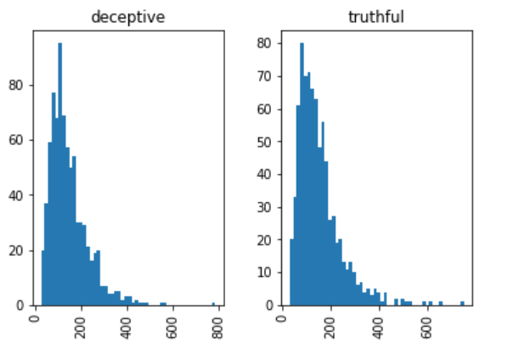
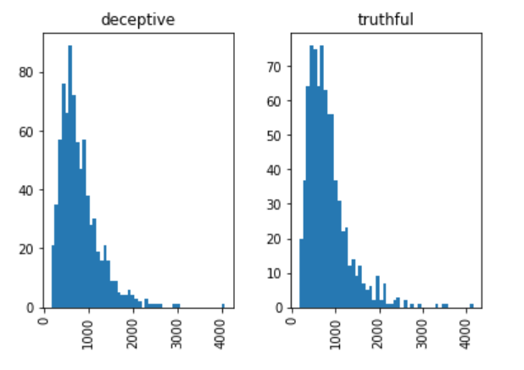
visualizations
Distribution of Count of Words in Reviews
Distribution of Count of Characters in Reviews

Slide 4
Data cleaning
Strip punctuation
Lowercase
Remove stop words (and, at, the, in)
Remove Stem words
“standing”, “stands”, “stand” all become “stand”

Slide 5
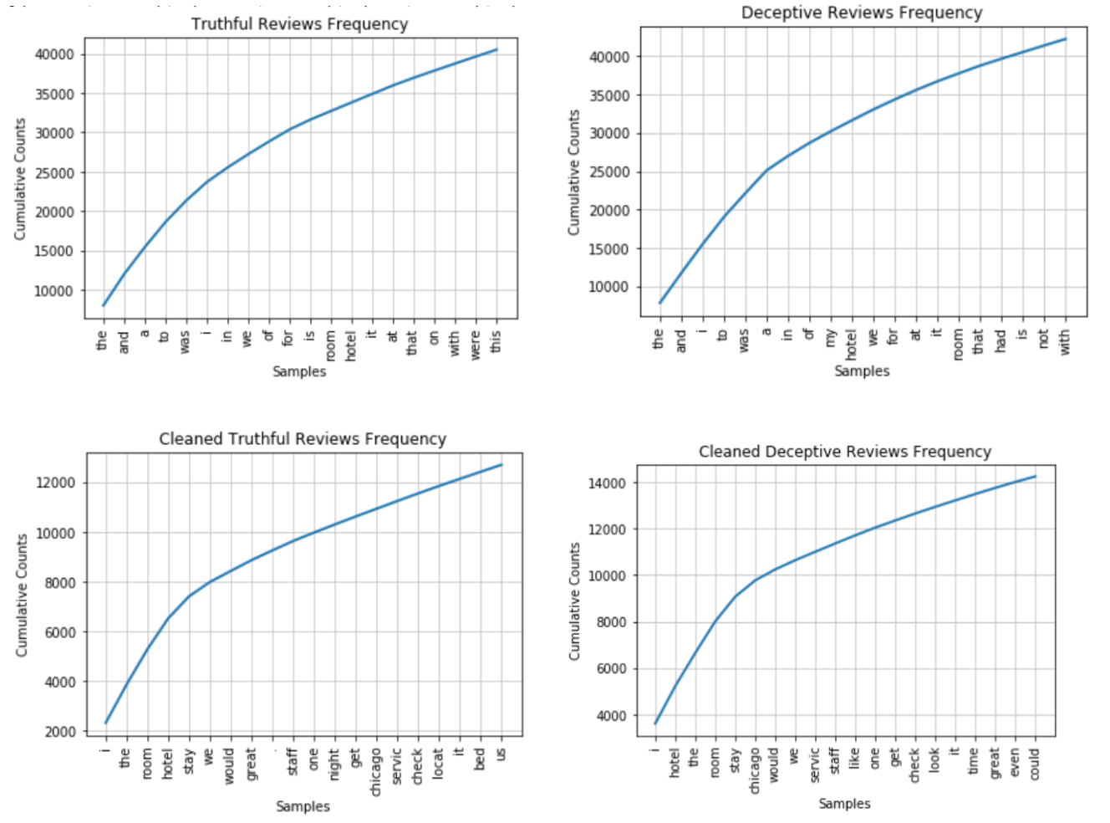
VisualizationS
Most Frequent
Different words in classes
Before Cleaning (above)
Mostly stopper words
After is more useful

Slide 6
Data Processing
Vectorize
TF-IDF
Embedding
Produce N-Grams (For Bayes Classifier)
Train-Test Split (shuffle)

Slide 7
Potential machine learning models
Random Forest Classifier (good)
Naïve Bayes algorithm (better)
Uses n-grams
Words appear in certain orders
Recurrent neural networks (most promising)
Word Embedding
Vectorize words

Slide 8
Training Models
Random Forest Classifier
Tf-idf Vectorizer
Given Corpus (vocabulary)
How important is a word to a document?
Select k best
K is the number of top features to consider
Chi squared measurement
Achieved 86.25% accuracy on test data

Slide 9
Training Models
Naïve Bayes Classifier
Multinomial Naïve Bayes
Events represent occurrence of words
Calculates likelihood of observing distribution
Achieved 89.69% accuracy on test data
N-gram in vectorizer tuned to 2 (more takes too much time)

Slide 10


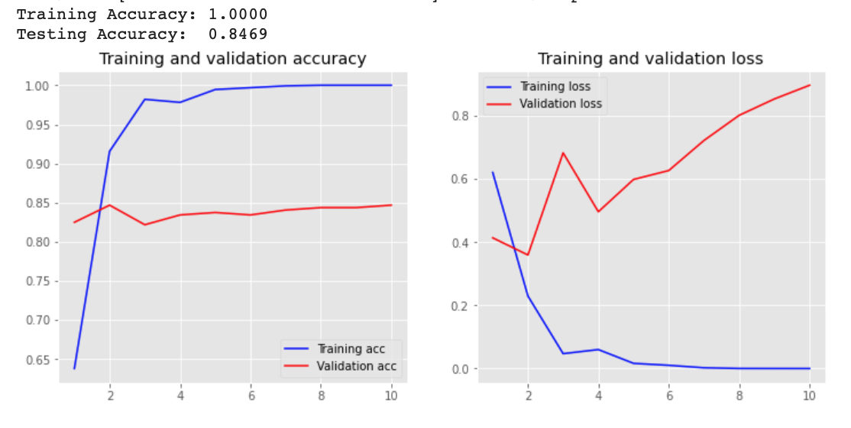
Training Models
Bi-Directional CNN
Embedding (learned)
Pad sequences
Builds corpus (vocabulary)
Achieved 84.69% accuracy on test
Even after tuning embedding dim

Slide 11
Conclusions
All three classifiers were effective
Naïve Bayes achieved highest accuracy
Also fast to train (CNN was slowest)
Still lagging in comparison to other research (96%)
Requires more fine-tuning
Automate parameters
Automate fine-tuning

